Slide 1



Dynamic Work Overview
Dynamic Work Overview
Maureen Kim
Senior Program Manager
Dynamic Work
Center for Workplace Development
Harvard Human Resources
dynamicwork@harvard.edu

Slide 2
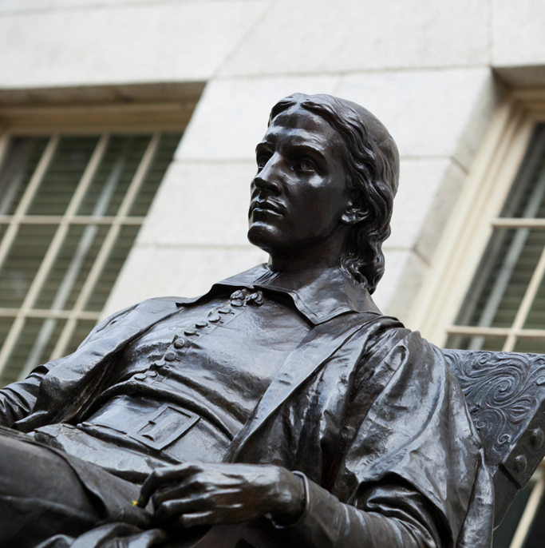
Dynamic Work Overview Highlights
Dynamic Work Overview Highlights
Setting the Context
What is Dynamic Work?
The Importance of Dynamic
Work at Harvard
Dynamic Work in Practice
Harvard Human Resources’ Role
Dynamic Work Resources
Summary

Slide 3

Dynamic Work Quote
The idea that we’re ever going to go back to work like we did in 2019 is a myth.”
Dr. John Howard, Director of the National Institute for Occupational Safety & Health

Slide 4

Harvard’s Priorities
Harvard’s Priorities
Residential Campus
21st Century Employer

Slide 5
Dynamic Work Overview Highlights: What is Dynamic Work?
Dynamic Work Overview Highlights
Setting the Context
What is Dynamic Work?

Slide 6

Dynamic Work Definition
Dynamic Work
Evolving ways employees can deliver their work:
on-campus, remotely, on a hybrid basis.
In standard and non-standard hours.
Aided by technology and workplace practices.
Maintain quality and timeliness of work and
interactions with colleagues, students, faculty,
researchers, alumni, and visitors.
When applicable, pace-flexibility, which may
inform where and when work is done based on
the volume of work at any given day, week,
month, or year.
Photo Credit: Maureen Kim

Slide 7

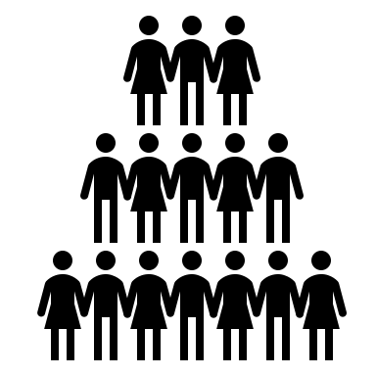


Dynamic Work vs. Flexwork
Dynamic Work
Holistic, strategic, & flexible arrangement at a group or organizational level
Example: Employees are expected to come into the office at least three days per week, to maintain a vibrant campus community while enabling flexibility around place.
Flexwork
Customized,
individual work arrangement
Example: To address personal needs, an employee may request* to be in the office only two days per week; deviating from the organization-wide arrangement.
*Employees must submit a formal application and submit a “Flexwork Proposal Form” for approval.

Slide 8
Dynamic Work Overview Highlights: The Importance of Dynamic Work at Harvard
Dynamic Work Overview Highlights
Setting the Context
What is Dynamic Work?
The Importance of Dynamic
Work at Harvard

Slide 9

Why Dynamic Work is Important for Harvard
Why Dynamic Work is Important for Harvard
Fundamental Change in the Workplace
  In recent years, the shift to remote work
  has tested the fundamentals of where,
  when, and how we work.
Increase in Productivity and Engagement
  Studies have shown that with more
  autonomy, employees were more
  productive, happier, and engaged.
Flexibility Critical to Job Retention
  Flexibility ranks second only to
  compensation in job satisfaction.
  More than 80% of employees expect jobs
  with some flexibility.
This is not a one-and-done solution; iterations are expected
and evolution constant during this dynamic time.

Slide 10

Dynamic Work Overview Highlights: Dynamic Work in Practice
Dynamic Work Overview Highlights
Setting the Context
What is Dynamic Work?
The Importance of Dynamic
Work at Harvard
Dynamic Work in Practice

Slide 11
Six Guiding Principles of Dynamic Work
How is Dynamic Work Implemented?
Six Guiding Principles of Dynamic Work
While implementation will differ across the institution,
these principles promote alignment of Dynamic Work efforts.
Dynamic and Evolving Workplace
Openness to iteration, experimentation,
and evolution of workplace arrangements
Intentional Presence
Commitment to a thoughtful analysis of
where and when work is done best
Outcomes-Based Performance
Prioritize outcomes and trust in
employees in distributed environments
Equity
Equity is not about identical results, but about
ensuring equitable access for all employees
Flexibility
Demonstrate flexibility in where, when,
and how work is performed
Well-being
Recognize the connection between employee’s
quality of life and their work performance

Slide 12
Dynamic Work Overview Highlights: HHR Role
Dynamic Work Overview Highlights
Setting the Context
What is Dynamic Work?
The Importance of Dynamic
Work at Harvard
Dynamic Work in Practice
Harvard Human Resources’ Role

Slide 13

HHR Role in Dynamic Work
Harvard Human Resources
Role in Dynamic Work
  Provides support and guidance to the
  Harvard community
  Captures university-wide input from key
  stakeholders and representative groups
    - Dynamic Work Advisory Council
    - Dynamic Work Working Group
    - The Higher Education Learning Group
    Provides insights and direction in
    Dynamic Work efforts
Please note: Dynamic Work strategies and working
arrangements are developed and applied at the local
level, based on operational and organizational needs.

Slide 14
Dynamic Work Overview Highlights: Dynamic Work Resources
Dynamic Work Overview Highlights
Setting the Context
What is Dynamic Work?
The Importance of Dynamic
Work at Harvard
Dynamic Work in Practice
Harvard Human Resources’ Role
Dynamic Work Resources

Slide 15

HHR Dynamic Work Support
Harvard Human Resources
Dynamic Work Support
This is a monumental shift to how we have
traditionally worked.
Harvard Human Resources wants to support
all our leaders, managers, and staff with the
skills they need to leverage these changes
and thrive in a Dynamic Work environment.
And to understand the core Dynamic Work
concepts, develop strategies, assess impact,
and achieve outcomes via recommendations.

Slide 16
HHR: Role Analysis Framework
Harvard Human Resources
Role Analysis Framework
Tool designed for assessing work arrangements by analyzing the role
based on the work, local priorities, and culture.
1. Mission: What is the mission? How does this role serve the mission?
2. Role: What is the purpose of the role? List key tasks, responsibilities, and constituents.
3. Portability: Are tasks dependent on non-portable services, equipment, or on-campus space?
4. Feasibility: Does the role focus on in-person interactions? Is place synchronicity important?
5. Flexibility: Explore if there are time and place constraints; pace opportunities within role.
Discuss and decide what working arrangement makes the most sense for the team/department and periodically reassess, as needed.
This tool helps provide transparency between all employees, maintain a balanced approach, and supports an objective process.

Slide 17
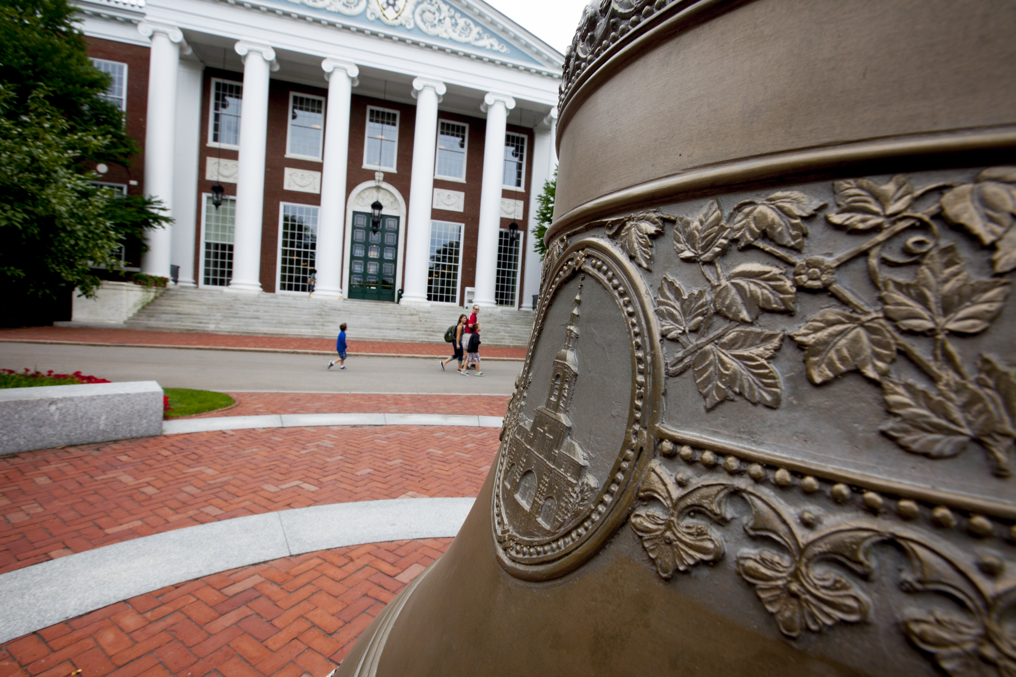
HHR Center for Workplace Development
Harvard Human Resources
Center for Workplace Development
Dynamic Work trainings and reference materials are available to help reinforce and build skills needed across Harvard in this evolving and dynamic environment.
To learn more about Dynamic Work and the resources available, please visit
the Dynamic Work page on the HARVie website: Dynamic Work | Harvard Human Resources.

Slide 18
Dynamic Work Overview Highlights: Summary
Dynamic Work Overview Highlights
Setting the Context
What is Dynamic Work?
The Importance of Dynamic
Work at Harvard
Dynamic Work in Practice
Harvard Human Resources’ Role
Dynamic Work Resources
Summary

Slide 19

Dynamic Work Summary
Dynamic Work Summary
In the last few years, traditional working
arrangements have been challenged.
Creating opportunities for more innovation and
evolution in where, when, and how we work.
Dynamic Work is a holistic approach at an
organizational level.
Flexwork allows for variations on workplace
arrangements on an individual level.
Dynamic Work strengthens Harvard’s ability to
retain and attract talent; and strengthens the
employees’ ability to deliver their best work.
The application of the shared values of the six
Principles of Dynamic Work promotes
alignment of Dynamic Work efforts.
Harvard Human Resources provides Dynamic
Work support, guidance, and resources to the
Harvard community.

Slide 20
Thank you
THANK YOU
Dynamic Work
Evolving & Dynamic Workplace
dynamicwork@harvard.edu

