Slide 2
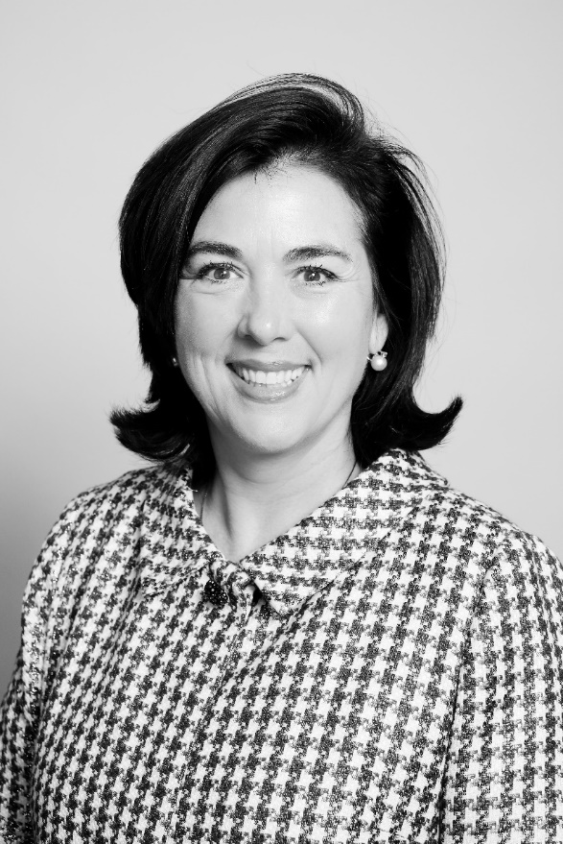
M. Trearty Bartley
Alumni Affairs and Development

Slide 3
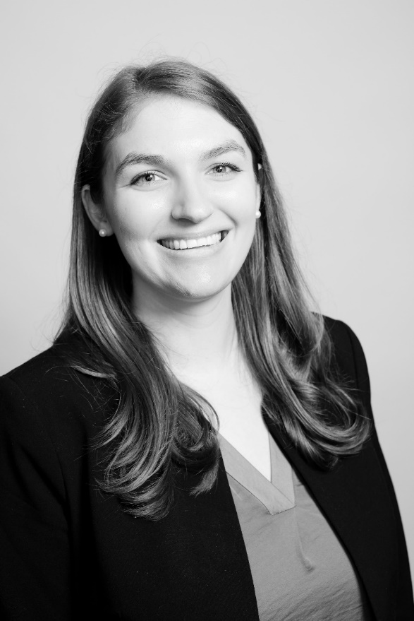
Caroline Miller
Alumni Affairs and Development

Slide 5
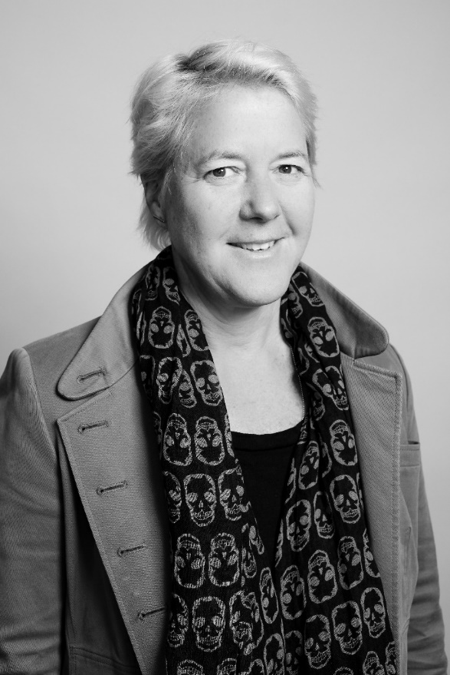
Kerry Herman
Harvard Business School

Slide 6
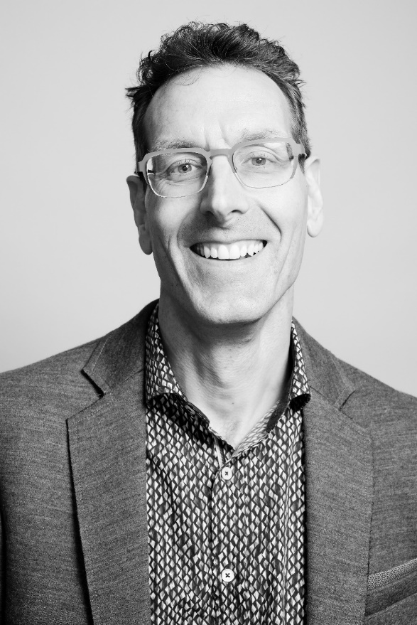
Kurt Piemonte
Harvard Business School

Slide 7
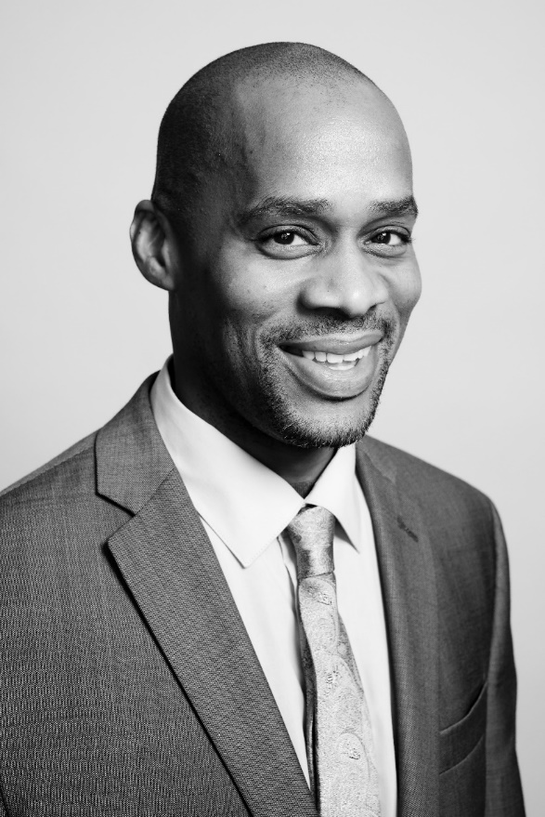
Ramone Sharpe
Harvard Business School

Slide 9
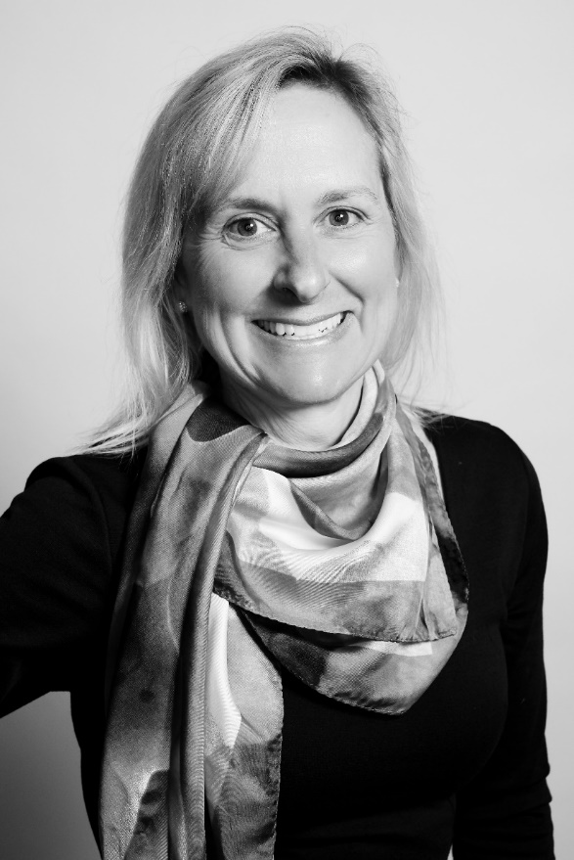
Elizabeth Ancarana
Office of the President and Provost

Slide 10
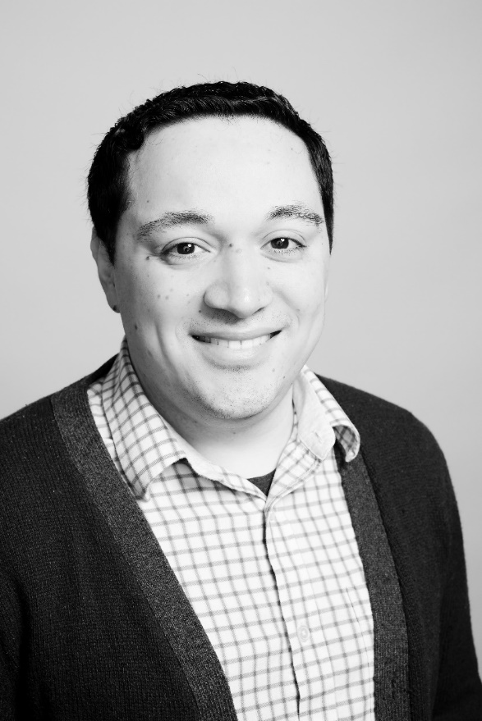
Luis Duarte
Office of the President and Provost

Slide 11
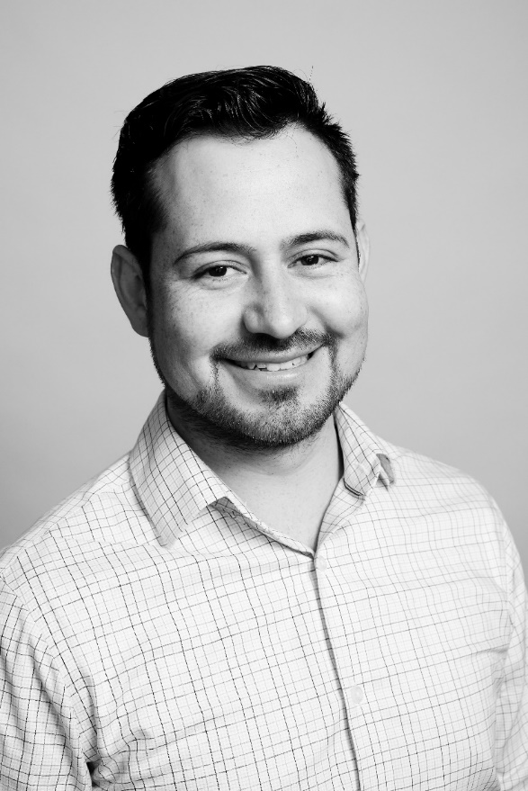
Jesus Romo Llamas
Office of the President and Provost

Slide 13
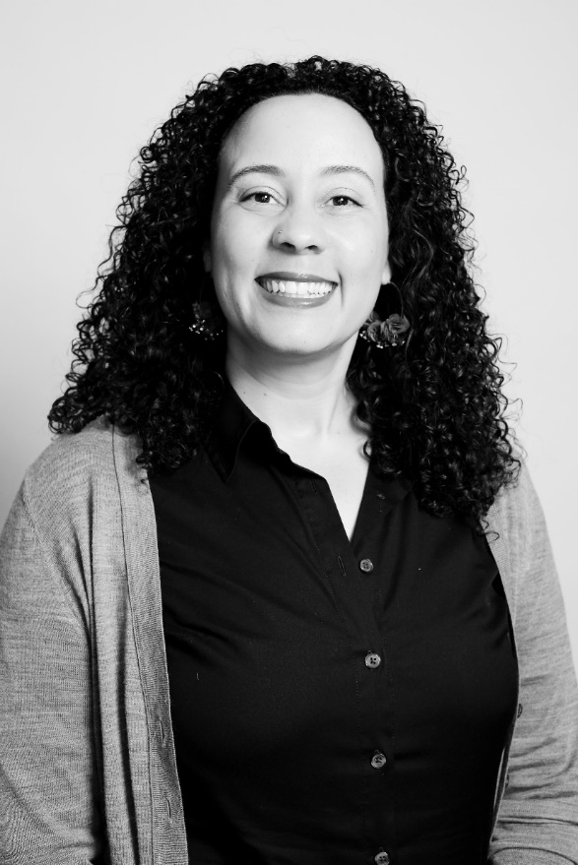
Lakshmi Clark
Harvard Law School

Slide 14
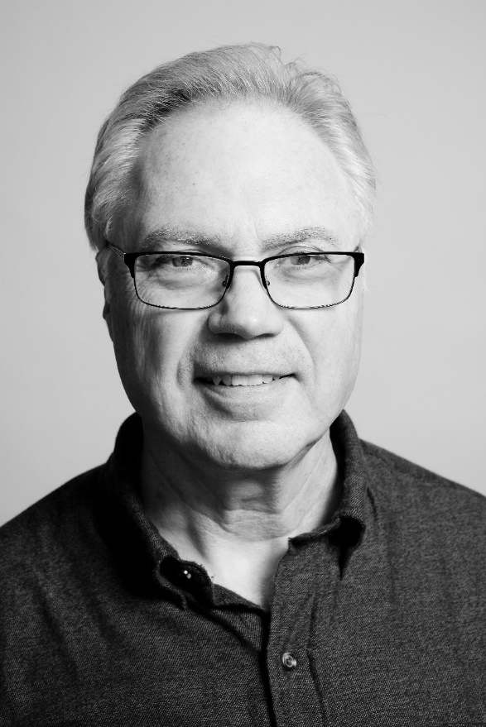
Russell Keyes
Harvard Law School

Slide 16
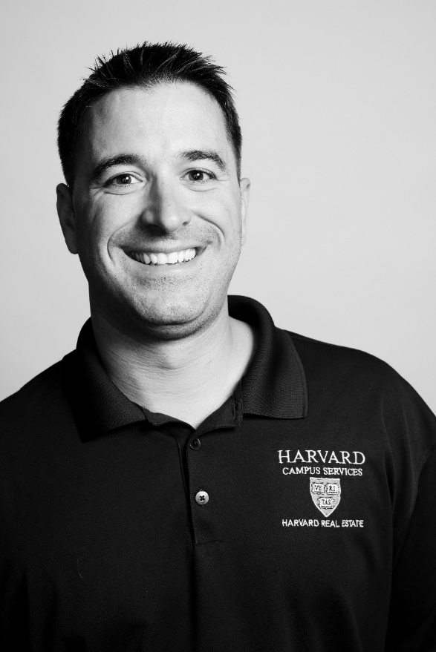
James Barbas
Campus Services

Slide 17
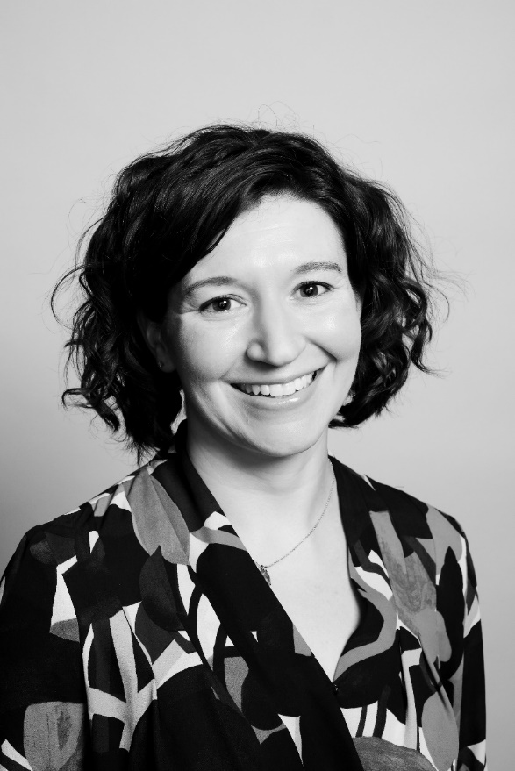
Elizabeth Capuano
Campus Services

Slide 18
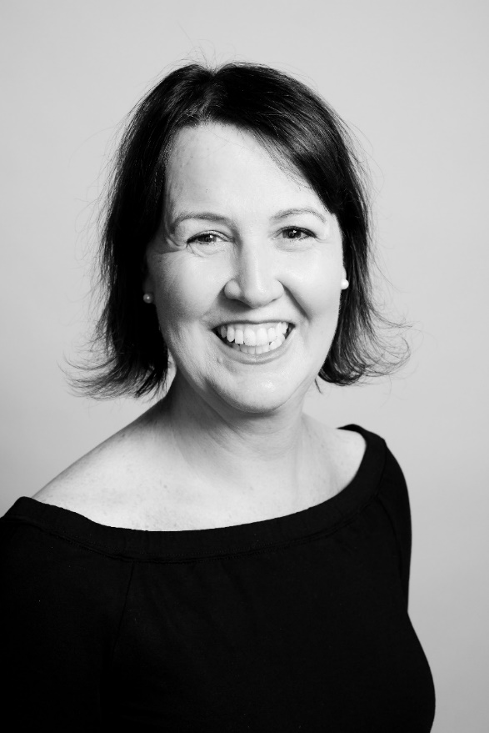
Deirdre Keady
Campus Services

Slide 19
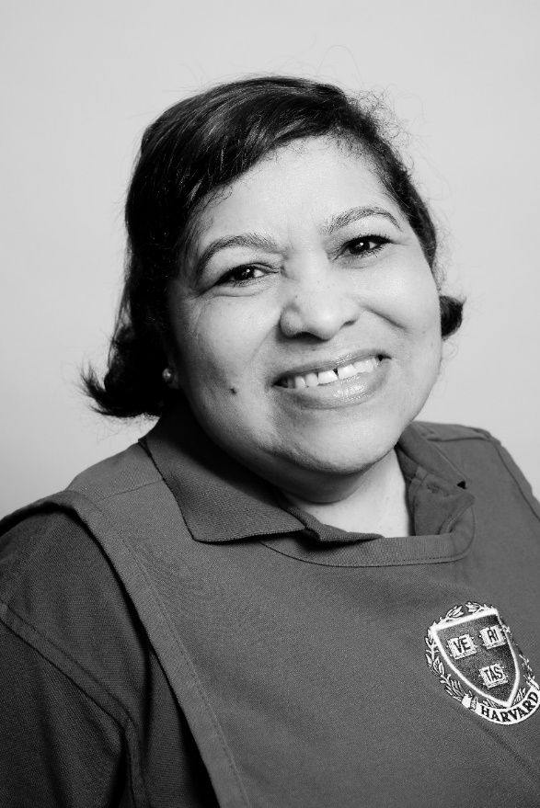
Amanda Montoya
Campus Services

Slide 20
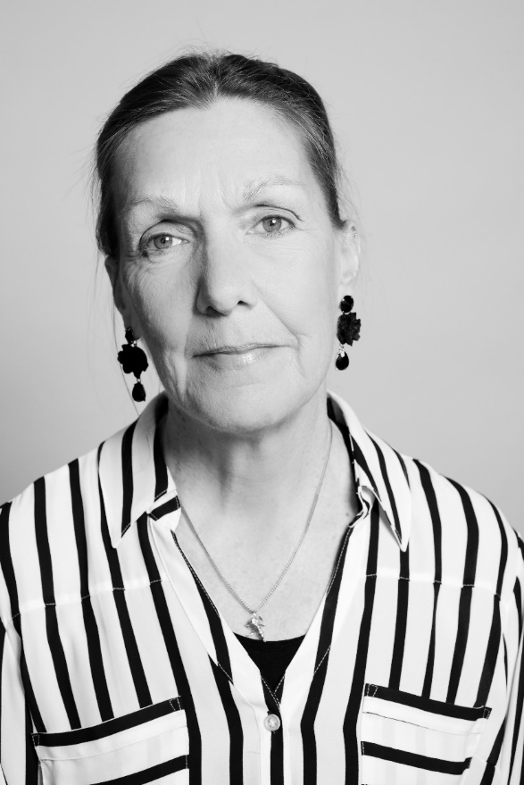
Patricia Prentice
Campus Services

Slide 22
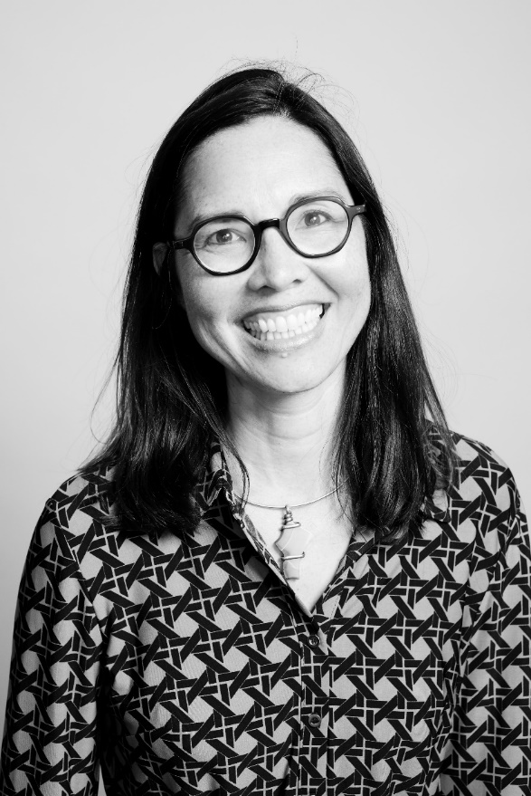
Maile Takahashi
Harvard Public Affairs & Communications

Slide 23
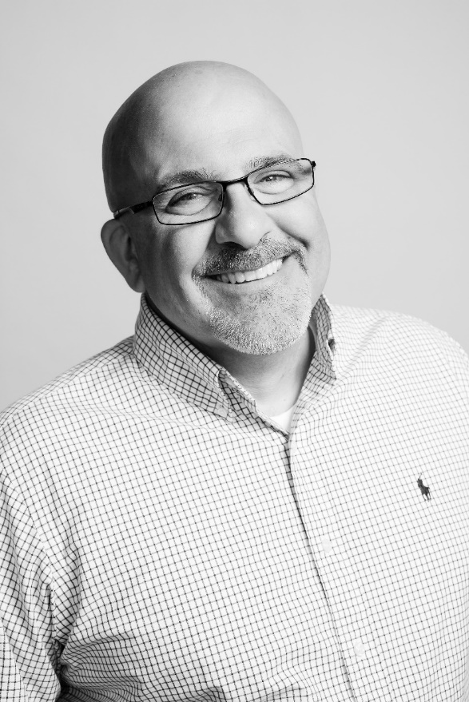
Mark Cicchetti
Harvard Medical School

Slide 24
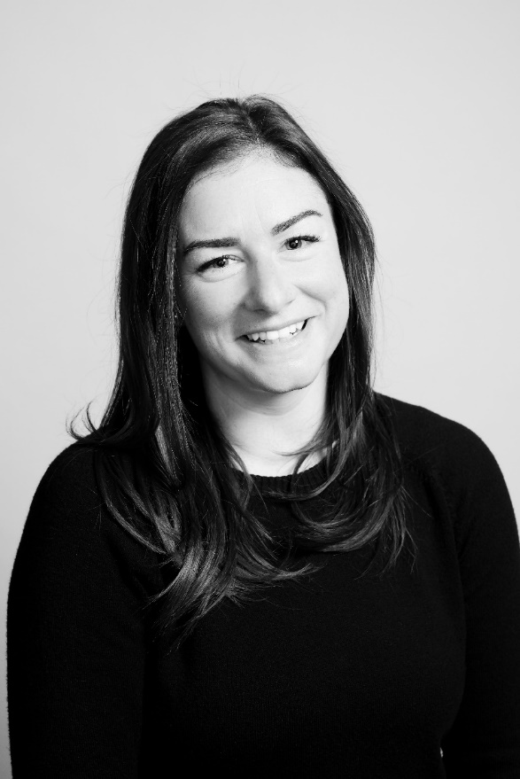
Emily Corcoran
Harvard Medical School

Slide 25
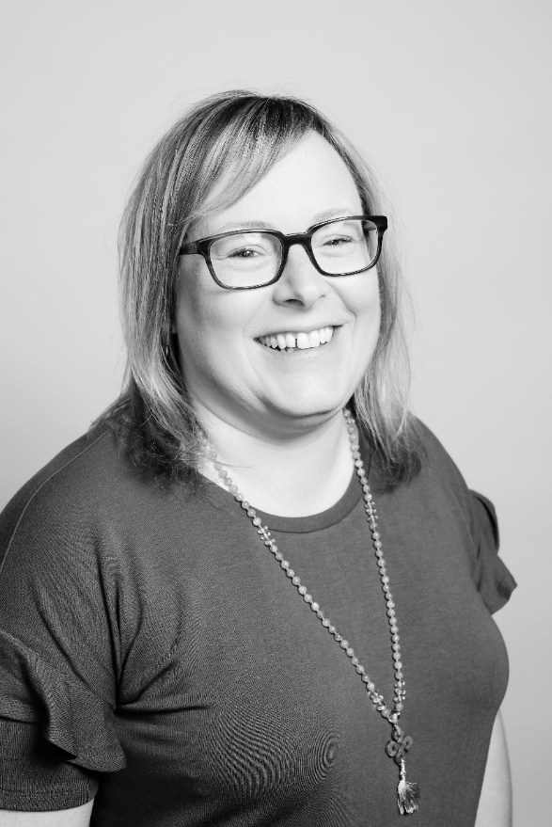
Laura DeCoste
Harvard Medical School

Slide 26
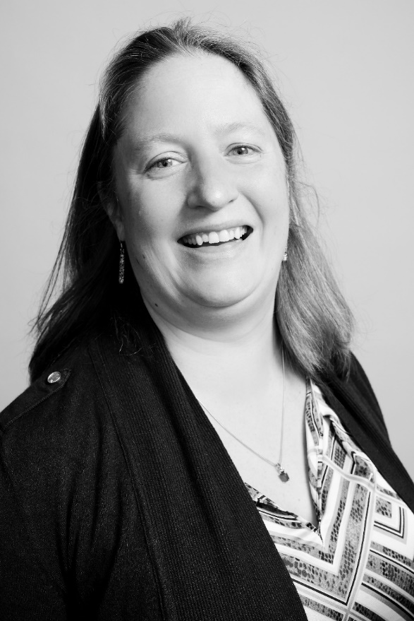
Molly Deschenes
Harvard School of Dental Medicine

Slide 27
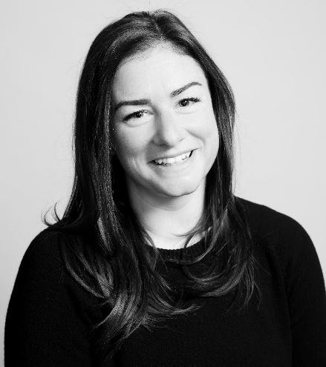

Slide 28
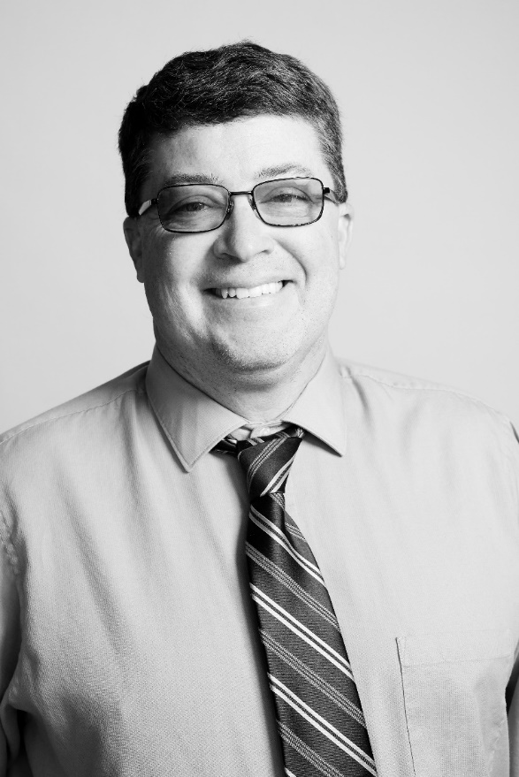
Don Gillis
Harvard Medical School

Slide 29
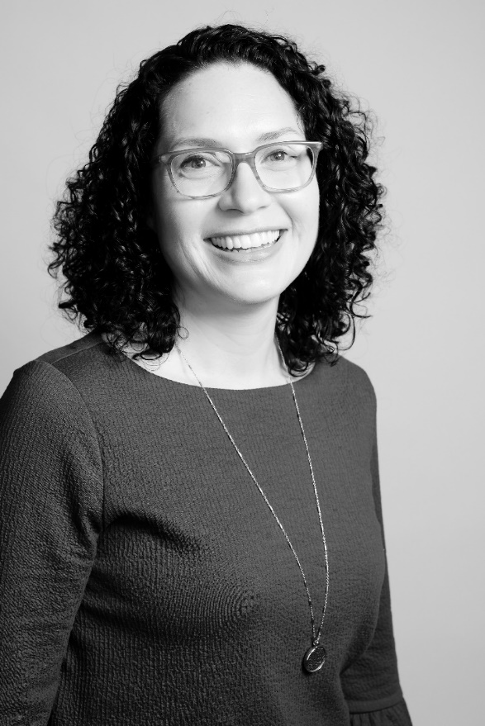
Megan Halligan
Harvard Medical School

Slide 30
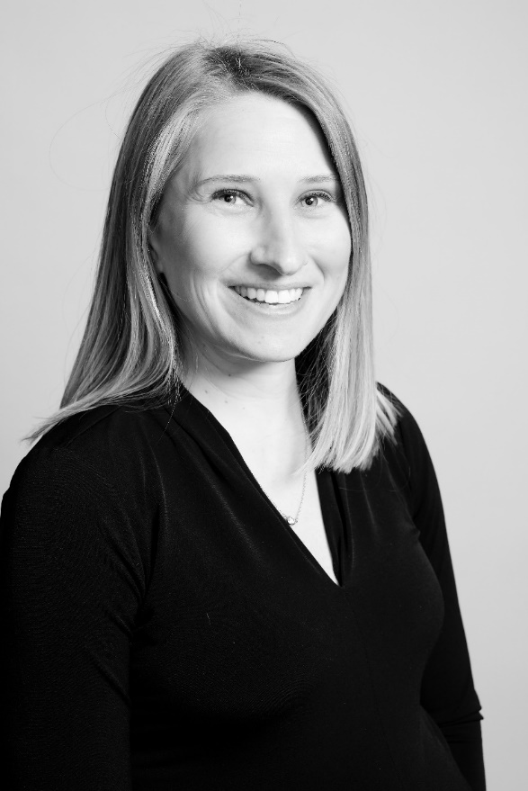
Leslie Howes
Harvard T.H. Chan School of Public Health

Slide 31
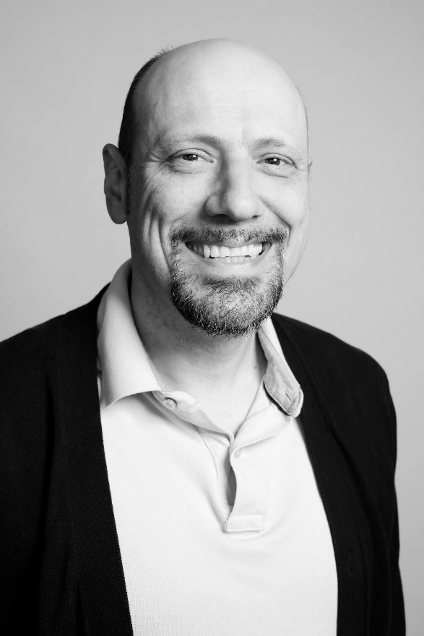
Armand Inezian
Harvard T.H. Chan School of Public Health

Slide 33
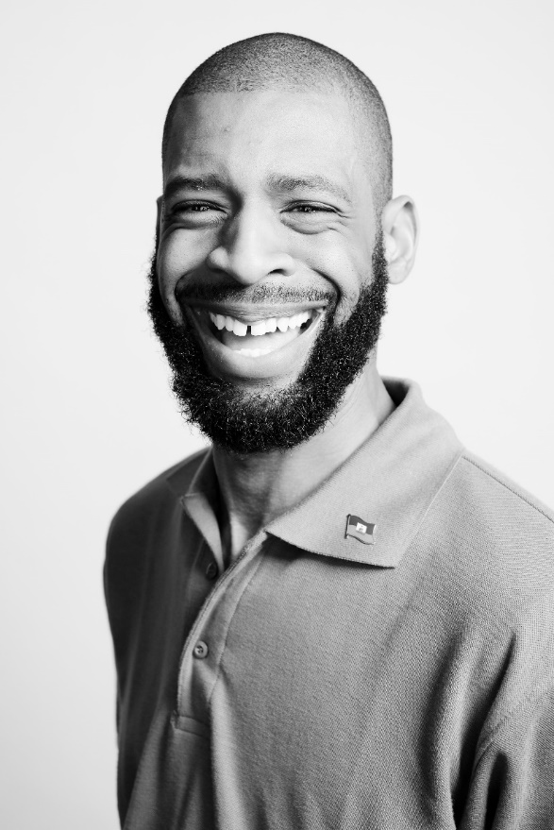
Donardo Marcellus
Harvard Medical School

Slide 34
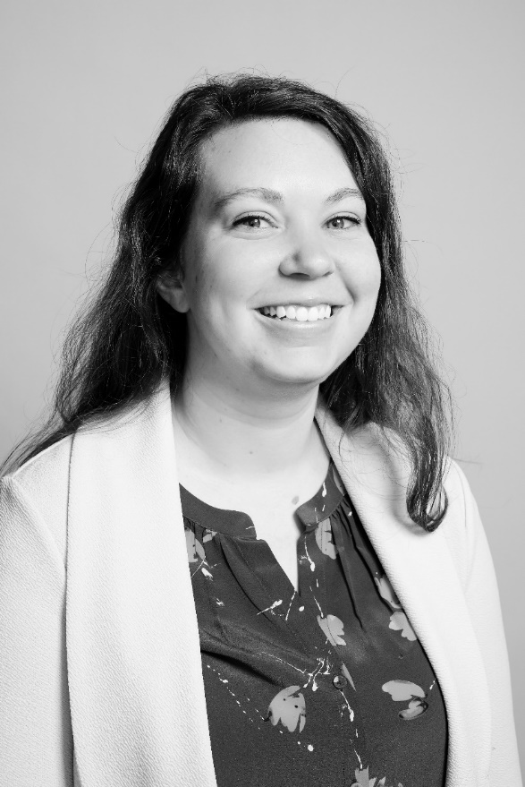
Alison McQuown
Harvard T.H. Chan School of Public Health

Slide 35
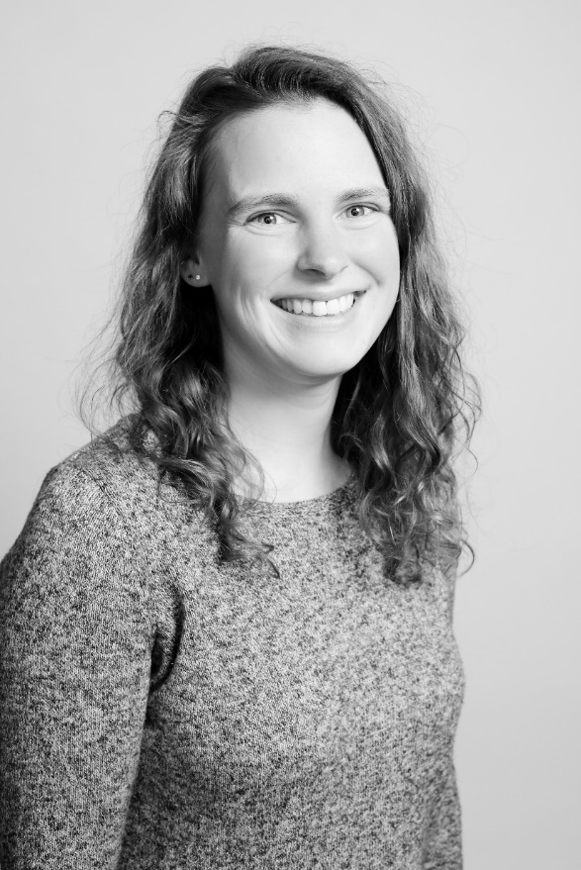
Megan Peavey
Harvard Medical School

Slide 36
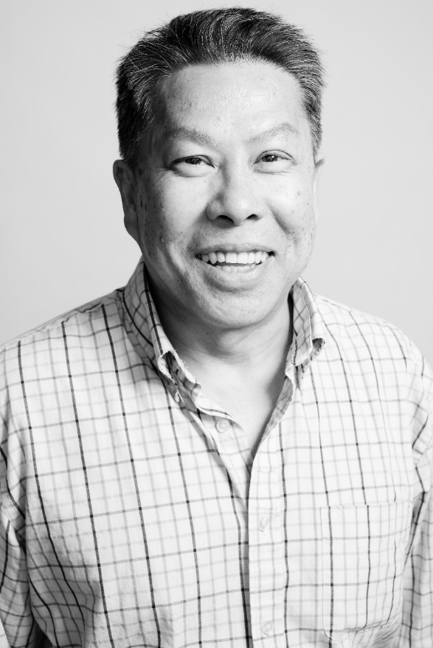
John Yong
Harvard T.H. Chan School of Public Health

Slide 38
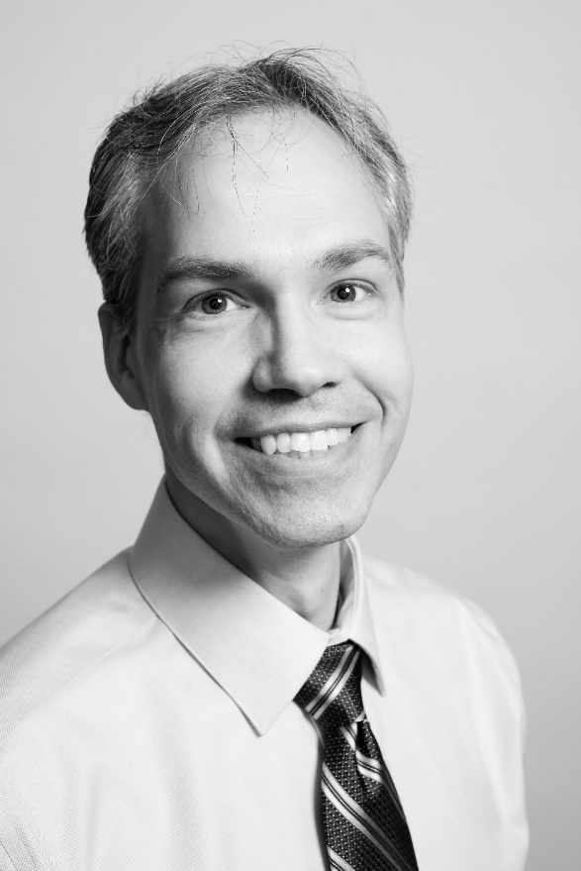
Matthew Boudreau
Financial Administration

Slide 39
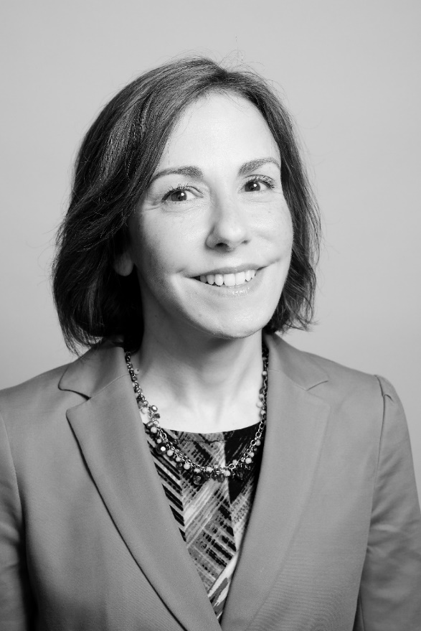
Andrea Sexton
Financial Administration

Slide 41
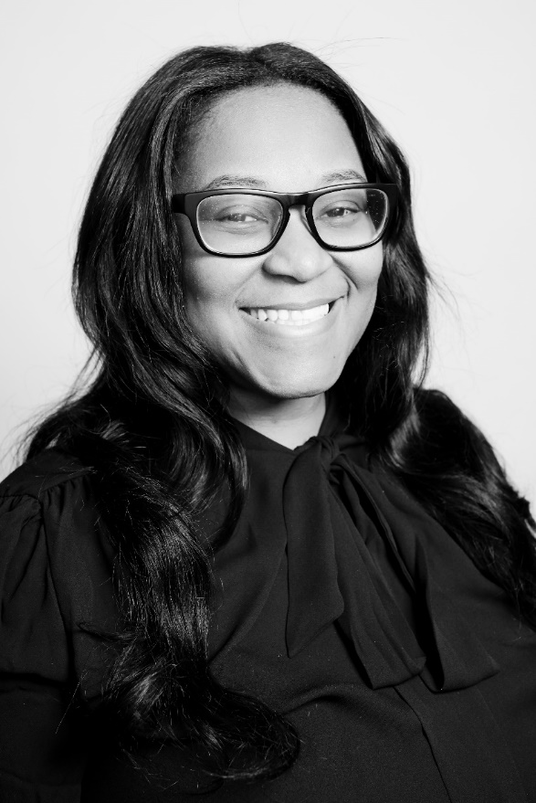
Shavonne Noble
Harvard Graduate School of Education

Slide 42
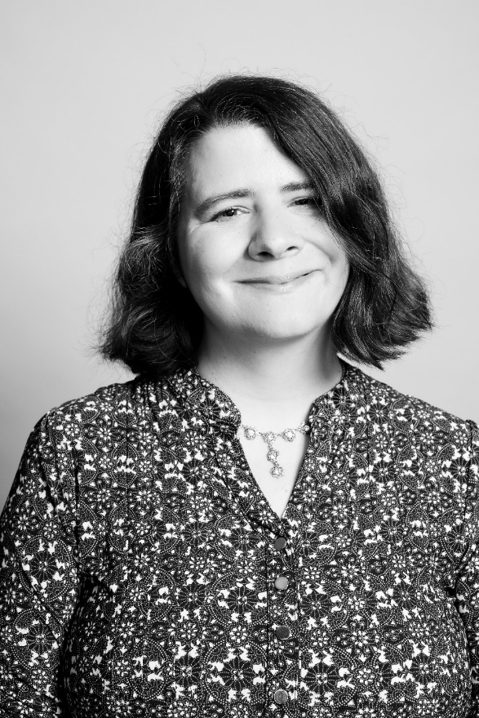
Sarah Timmins
Harvard Graduate School of Education

Slide 45
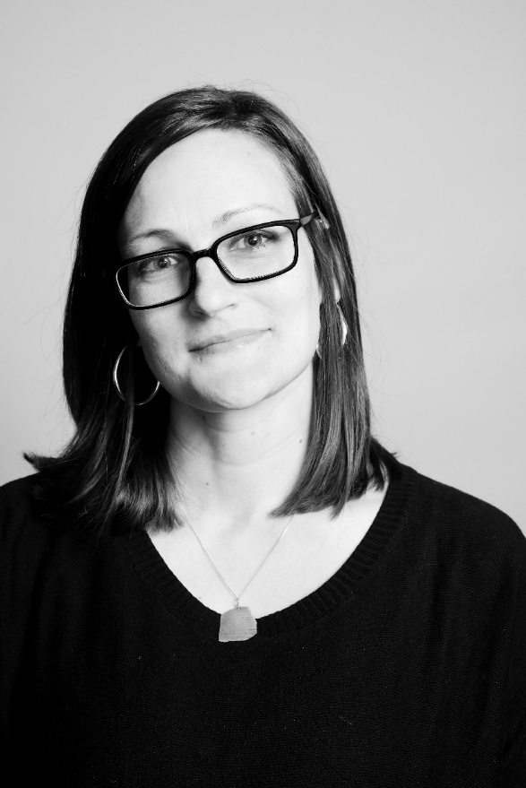
Tiffany Blackman
Harvard Faculty of Arts and Sciences

Slide 46
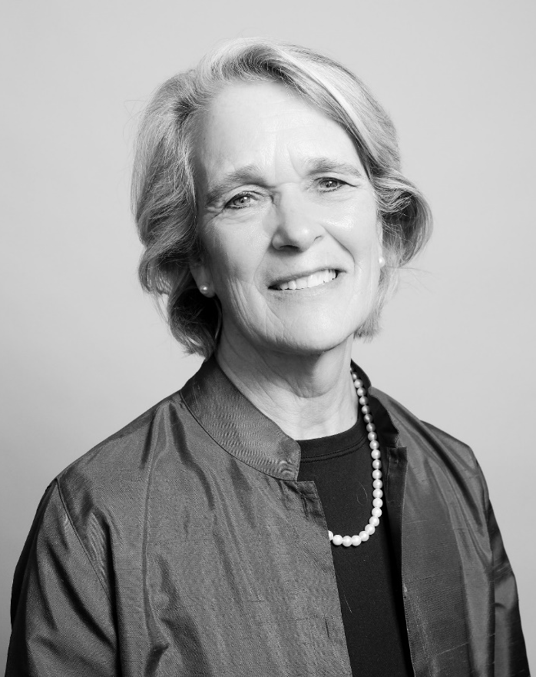
Sally Donahue
Harvard Faculty of Arts and Sciences

Slide 47
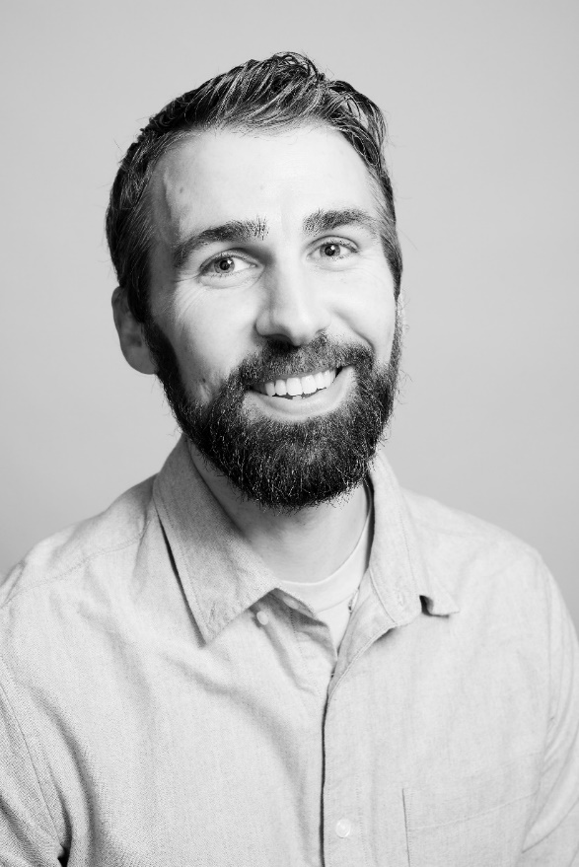
Christian Franco
Harvard Faculty of Arts and Sciences

Slide 48
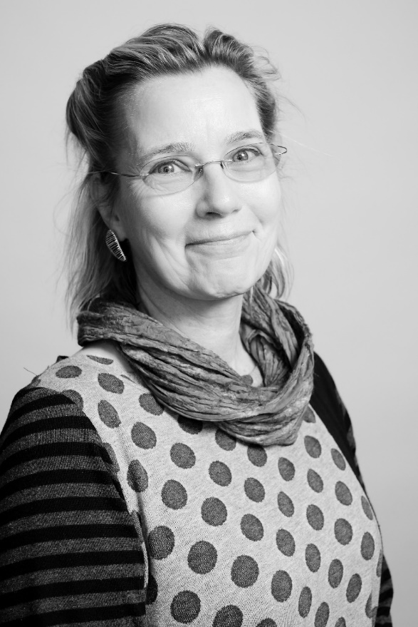
Renate Hellmiss
Harvard Faculty of Arts and Sciences

Slide 49
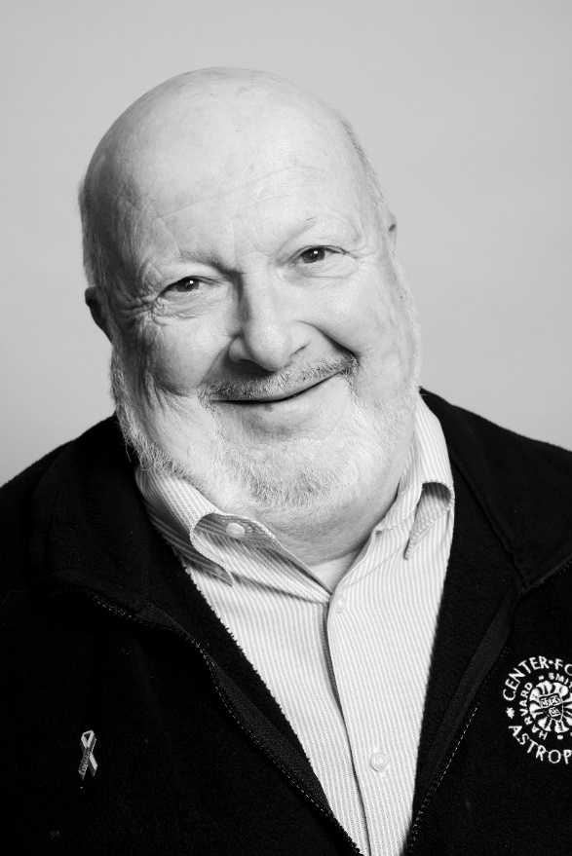
Charles Hickey
Harvard Faculty of Arts and Sciences

Slide 50
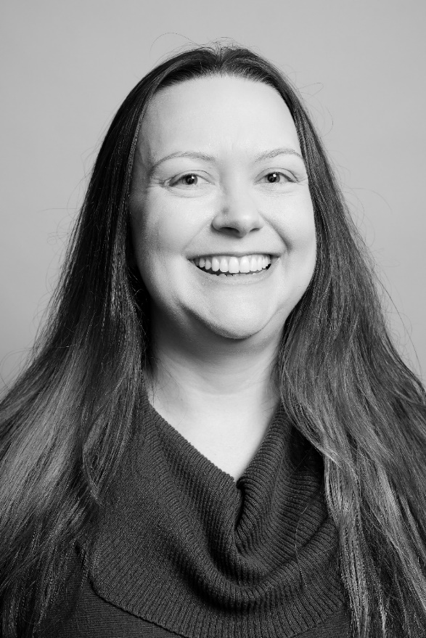
Krista Lester
Harvard Faculty of Arts and Sciences

Slide 51
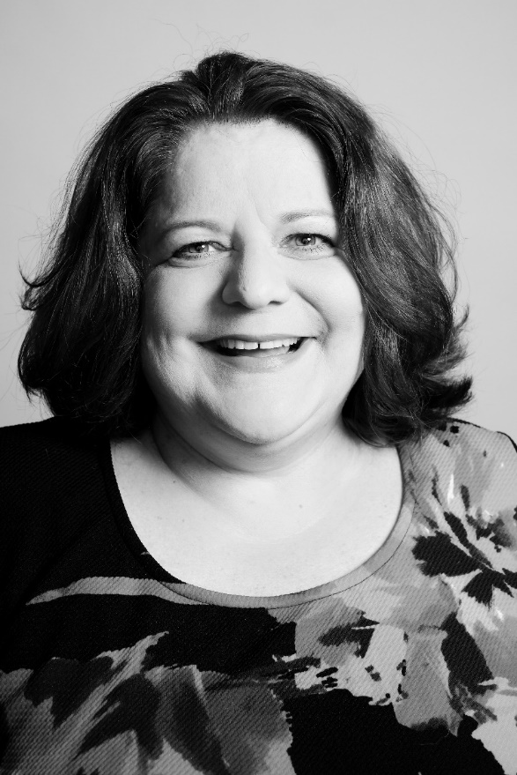
Jessica Matteson
Harvard Faculty of Arts and Sciences

Slide 52
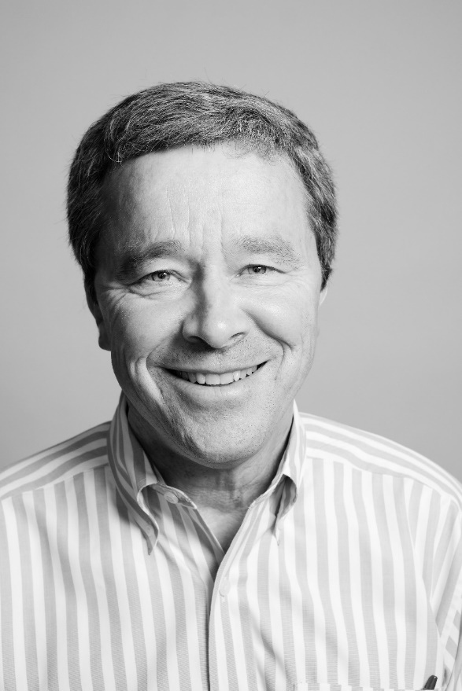
Jack Megan
Harvard Faculty of Arts and Sciences

Slide 53
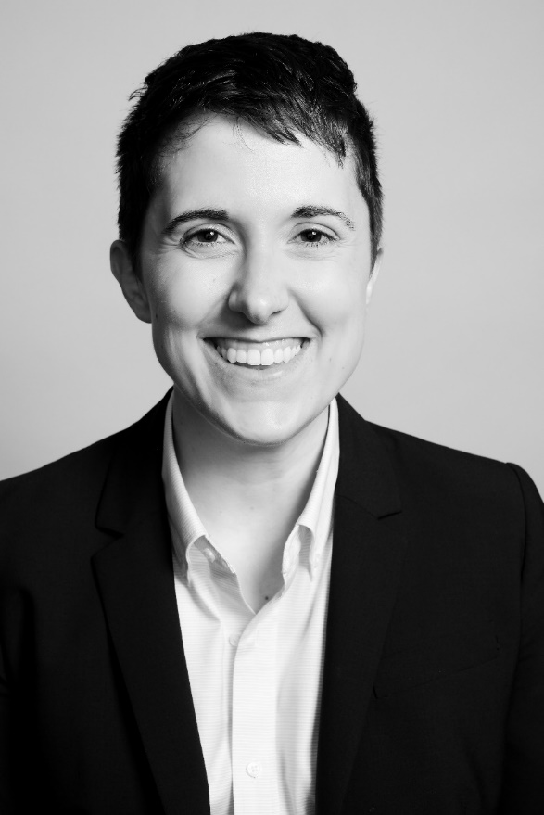
Emily J. Miller
Harvard Faculty of Arts and Sciences

Slide 54
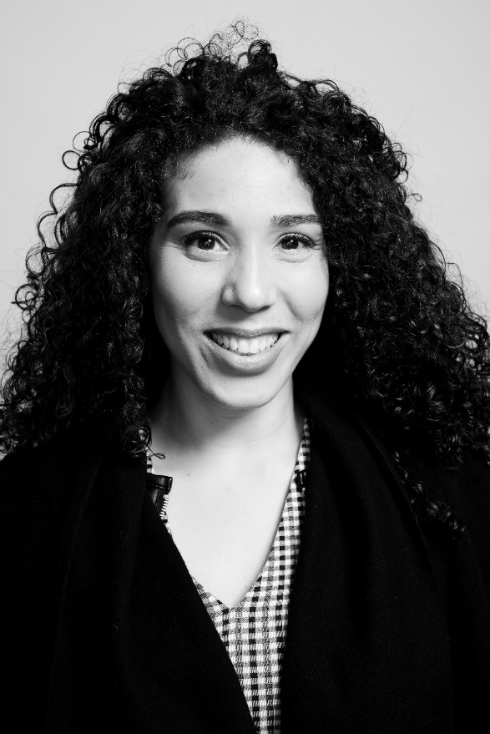
Michelle Monestime
Harvard Faculty of Arts and Sciences

Slide 55
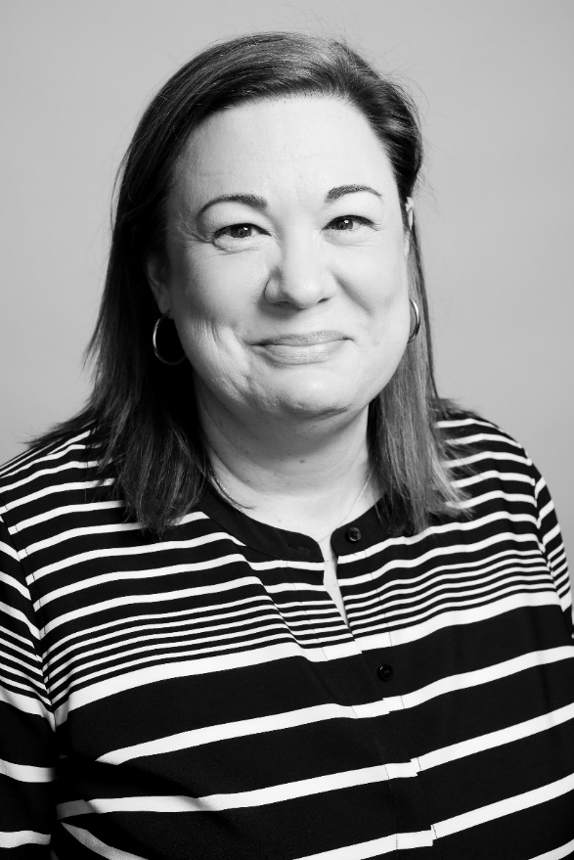
Stephanie Nasson
Harvard Faculty of Arts and Sciences

Slide 56
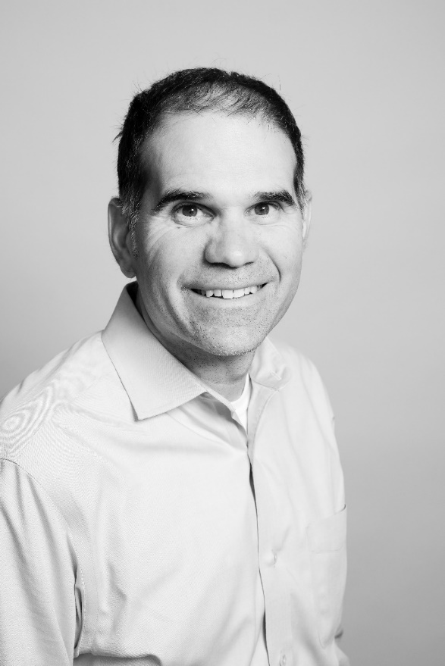
Gregg Tucci Harvard Faculty of Arts and Sciences

Slide 57
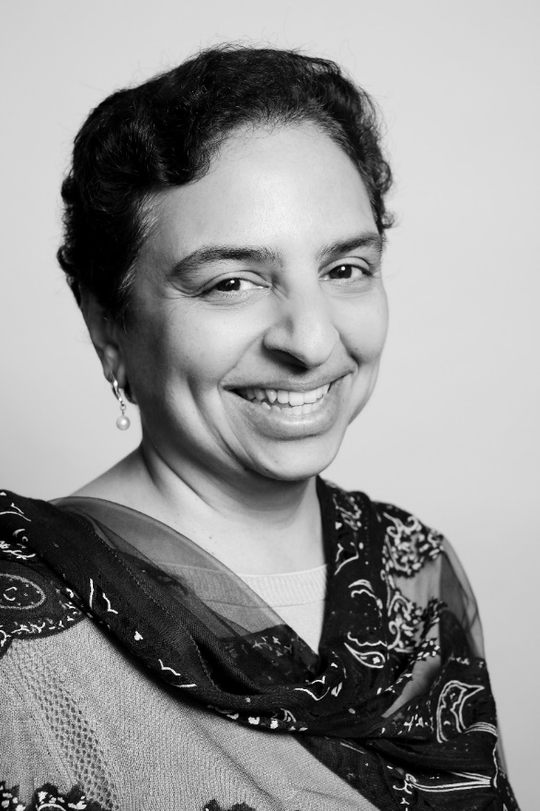
Anu Vedantham Harvard Faculty of Arts and Sciences

Slide 58
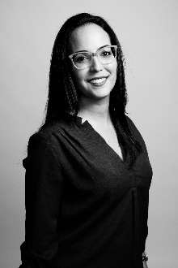
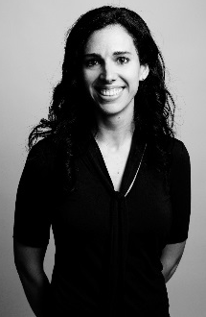

Slide 59
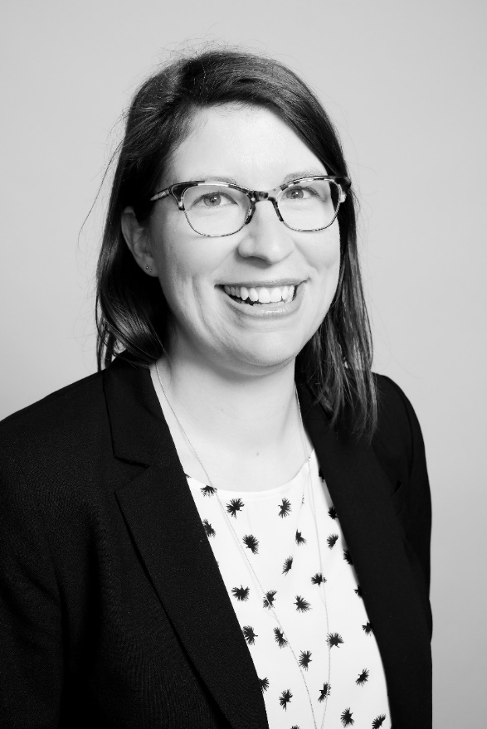
Amy Deschenes
Harvard Library

Slide 60
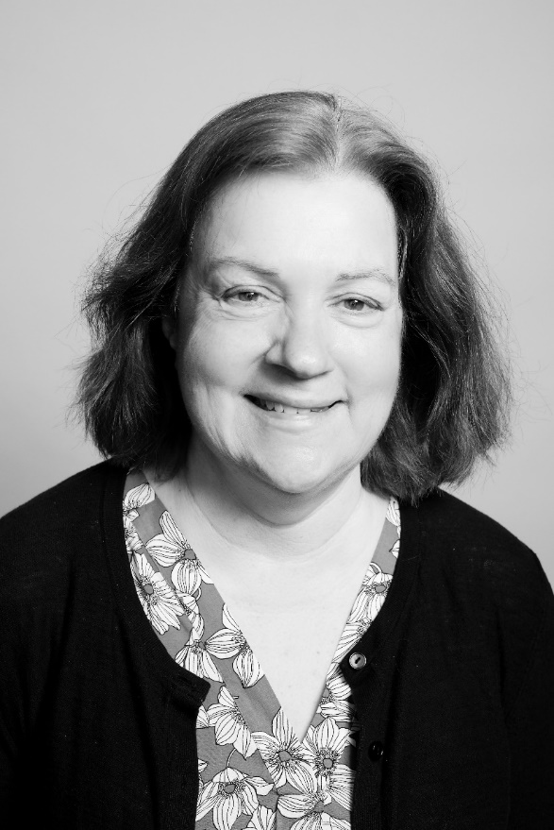
Barbara Meloni
Harvard Library

Slide 62
Ruth Hill
Radcliffe Institute for Advanced Study

Slide 63
Michael Maguire
Harvard Kennedy School

Slide 64
Rashida Nisbett
Harvard Kennedy School

Slide 66
Susan Forrest
Harvard John A. Paulson School of Engineering and Applied Sciences

Slide 67
Pilar Raynor Jordan
Harvard Graduate School of Design

Slide 68
Angela Sigal-Poock
Harvard University Health Services

Slide 69
Sharon Bayer
Harvard University Information Technology

Slide 70
Paige Duncan
Harvard University Information Technology

Slide 72
Beth Flaherty
Harvard Divinity School

Slide 73
Denis Downing
Harvard University Police Department

Slide 74
Jim Gotimer
Harvard Human Resources

