Slide 2
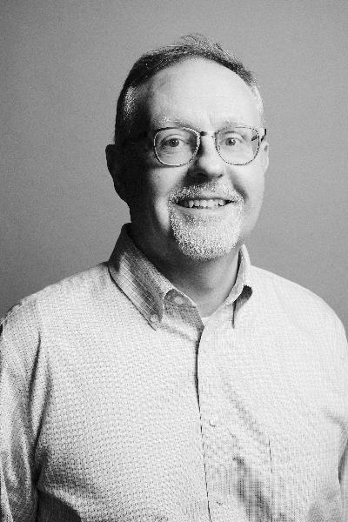
Mark Verkennis
Harvard Planning Office

Slide 3
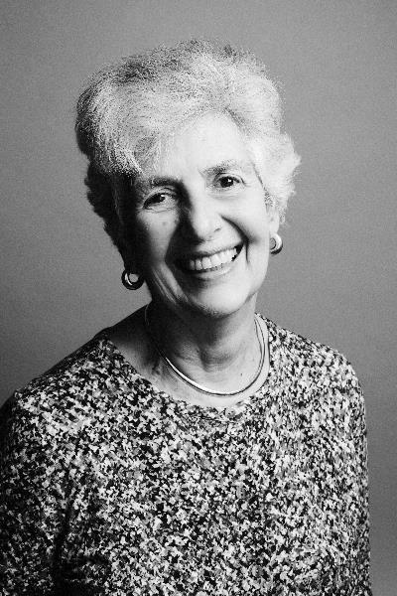
Virginia Brooks
Alumni Affairs and Development

Slide 4
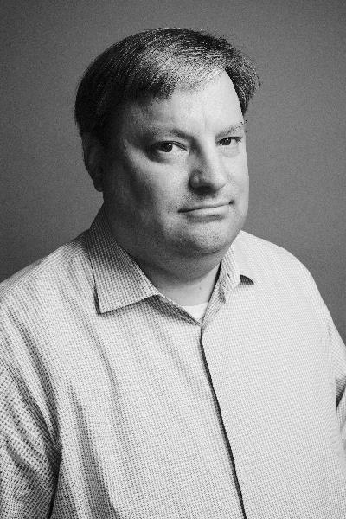
Paul Dzus
Alumni Affairs and Development

Slide 6
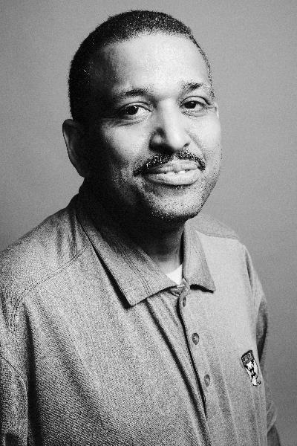
Ricardo Aviles
Harvard Business School

Slide 7
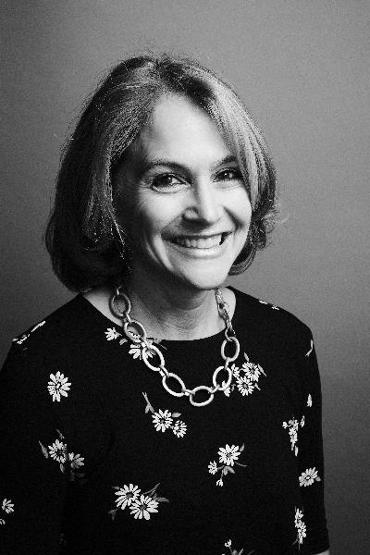
Jill H. Fadule
Harvard Business School

Slide 8
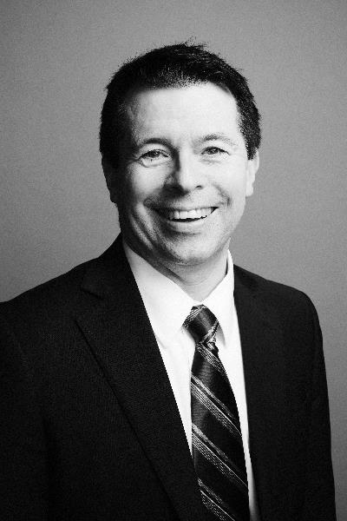
Steve O’Donnell
Harvard Business School

Slide 9
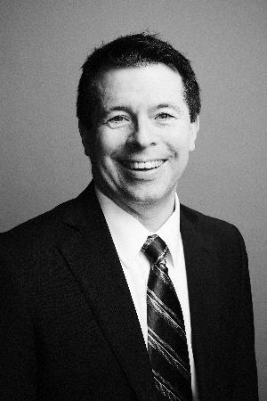

Slide 10
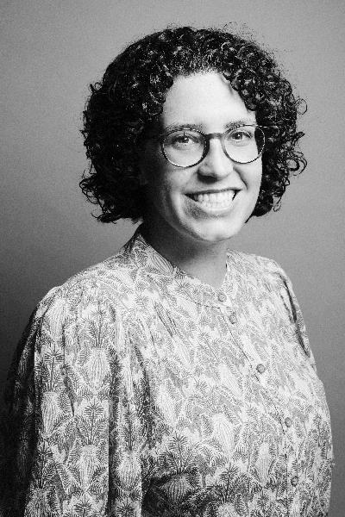
Erin Northington
Harvard Art Museums

Slide 11
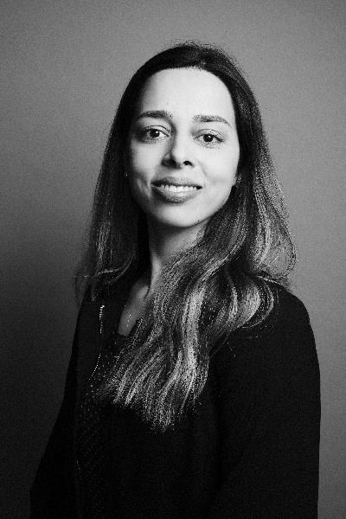
Aline de Araujo Santos
LASPAU

Slide 12
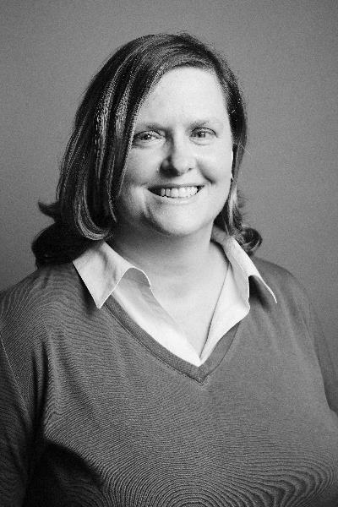
Melissa Bergsten
Harvard Law School

Slide 13
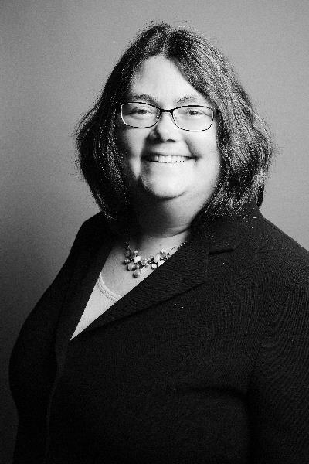
Sheryl Dickey
Harvard Law School

Slide 15
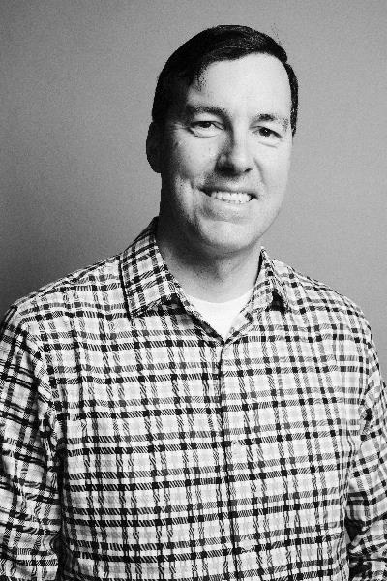
Thomas Becker
Campus Services

Slide 16
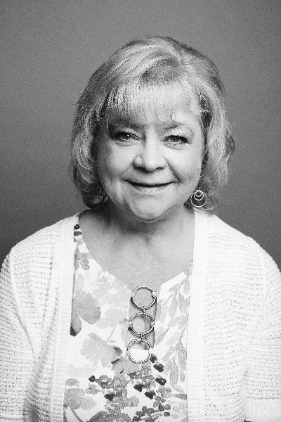
Paula O’Callahan
Campus Services

Slide 17
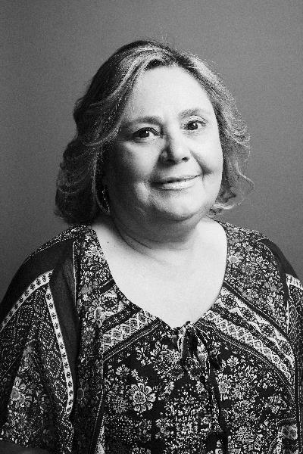
Ana Soares
Campus Services

Slide 18
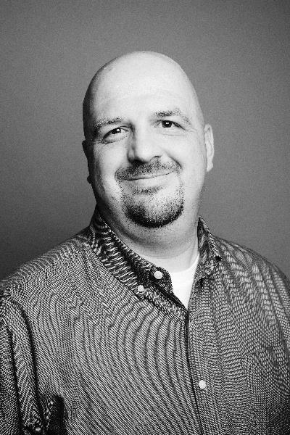
Peter Underhill
Campus Services

Slide 19
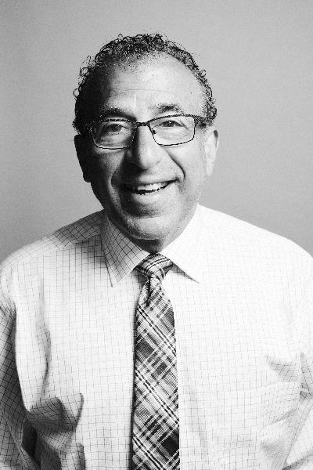
George Yeomelakis
Campus Services

Slide 20
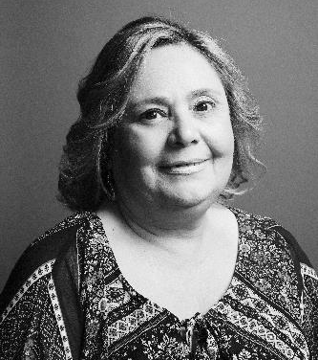

Slide 21
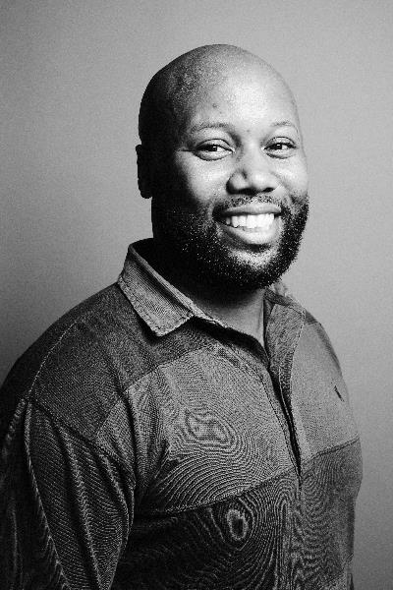
Brandon M. Tilghman
Harvard John A. Paulson School of Engineering and Applied Sciences

Slide 22
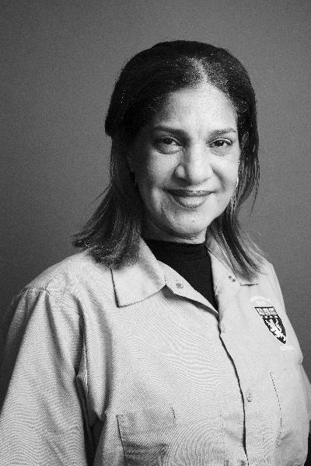
Mirta D. Guerrero Tejeda
Harvard Medical School

Slide 23
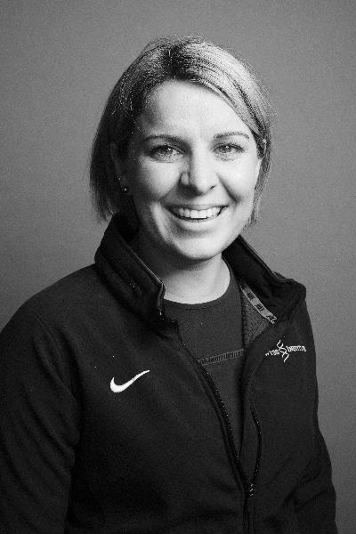
Margaret Ivins
Harvard Medical School

Slide 24
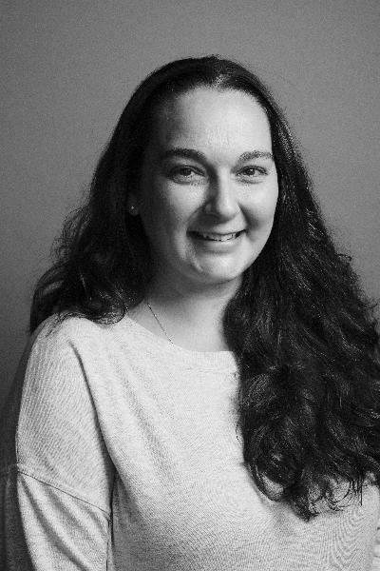
Laurie O’Connor
Harvard Medical School

Slide 25
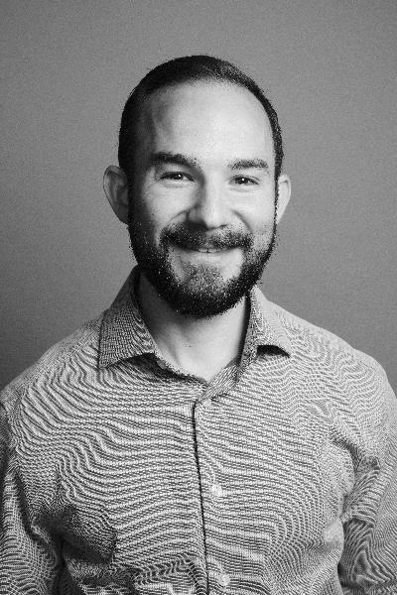
Evan Sanders
Harvard Medical School

Slide 26
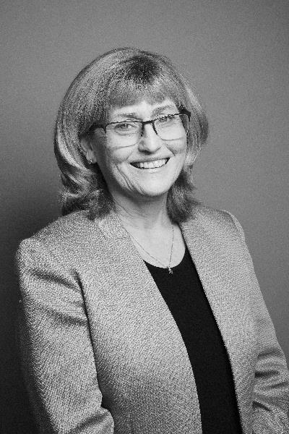
Deborah Corwin Scott
Harvard Medical School

Slide 27
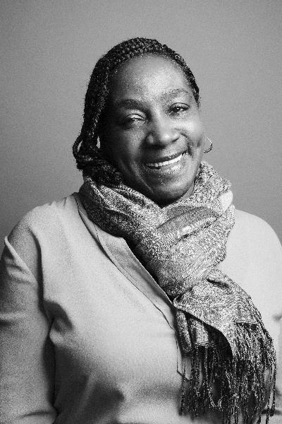
Rainelle B. Walker White
Harvard Medical School

Slide 28
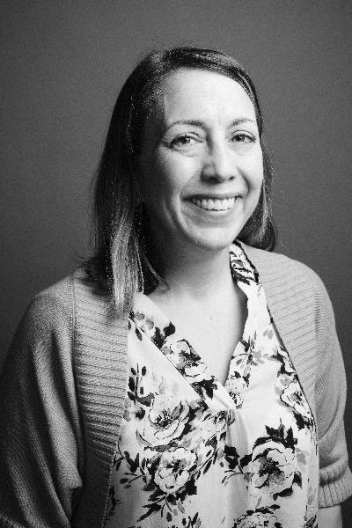
Mary Walsh
Harvard Medical School

Slide 29
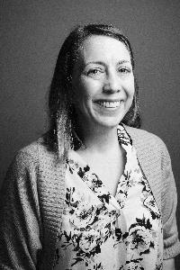

Slide 30
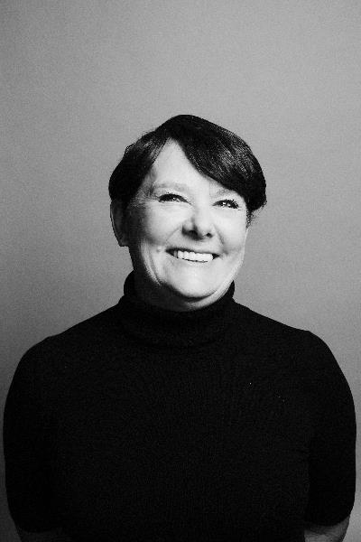
Mary E. Anderson
Harvard School of Dental Medicine

Slide 31
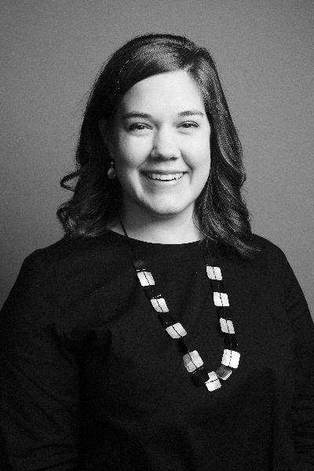
Emily Coles
Harvard T.H. Chan School of Public Health

Slide 32
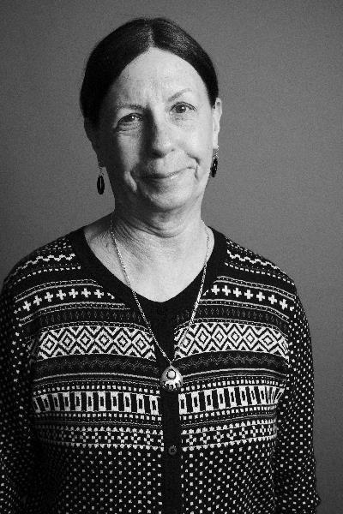
Hilary Farmer
Harvard T.H. Chan School of Public Health

Slide 33
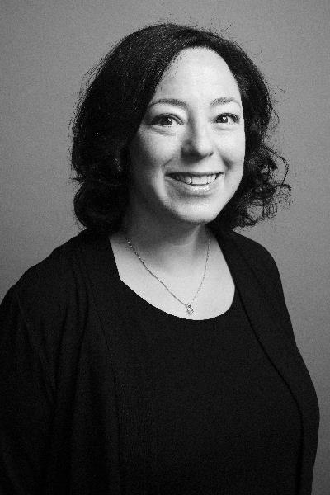
Jennifer Ford
Harvard T.H. Chan School of Public Health

Slide 34
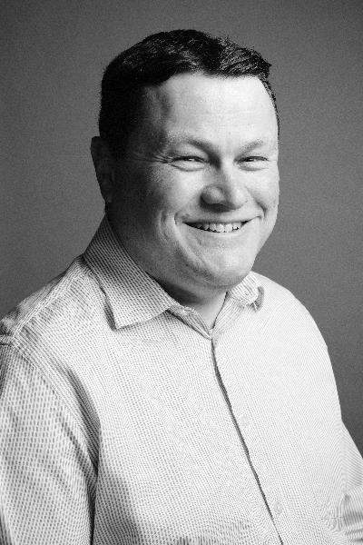
Brian Frederick
Harvard T.H. Chan School of Public Health

Slide 36
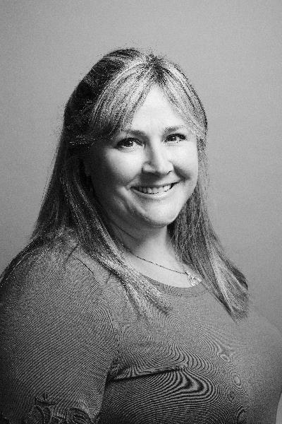
Jeanine Toler
Financial Administration

Slide 37
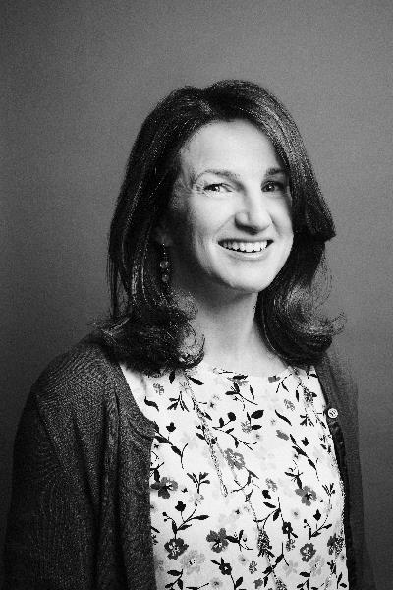
Helen Zdybowicz
Financial Administration

Slide 39
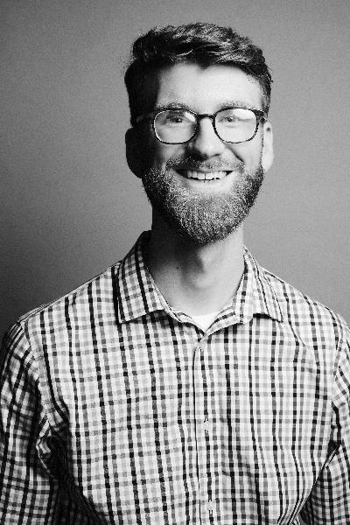
Ian Dalley
Harvard Kennedy School

Slide 40
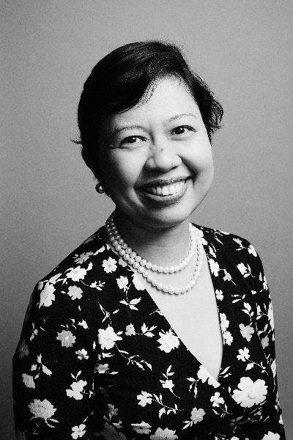
Myrish Cadapan Antonio
Harvard Kennedy School

Slide 42
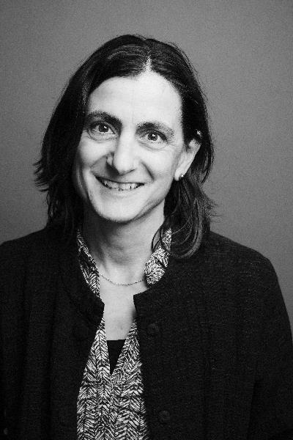
Odette Binder
Harvard Faculty of Arts and Sciences

Slide 43
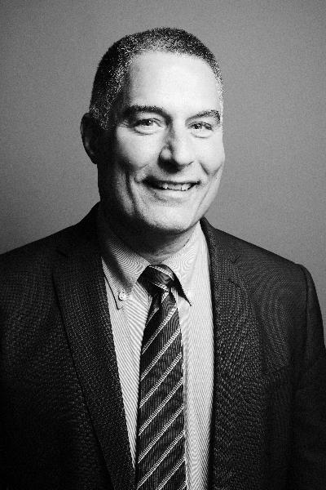
Gary Cormier
Harvard Faculty of Arts and Sciences

Slide 44
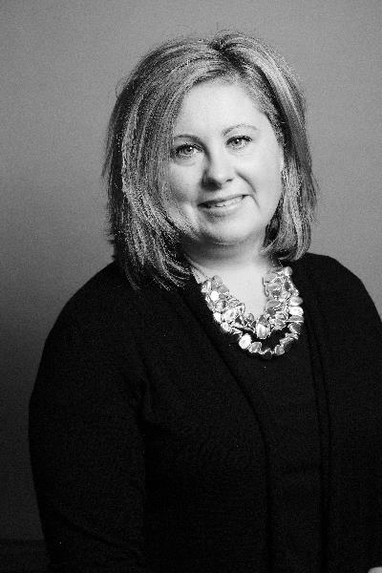
Sarah Elwell
Harvard Faculty of Arts and Sciences

Slide 45
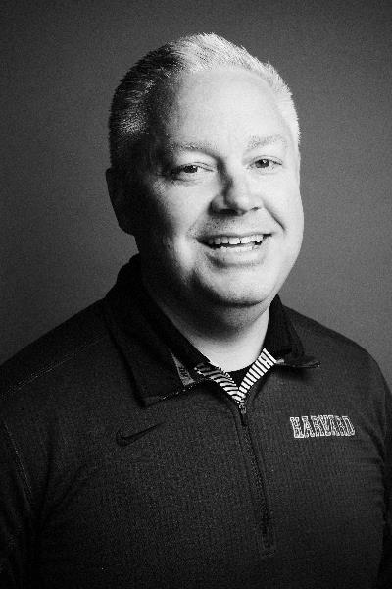
Alex Ferguson
Harvard Faculty of Arts and Sciences

Slide 46
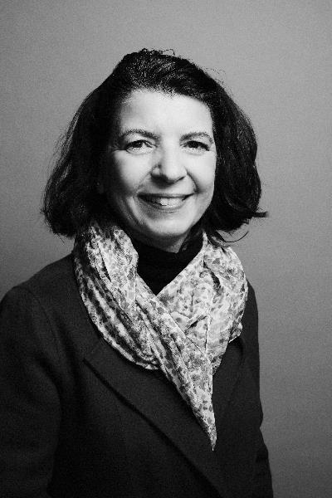
A. Maryorie Grande
Harvard Faculty of Arts and Sciences

Slide 47
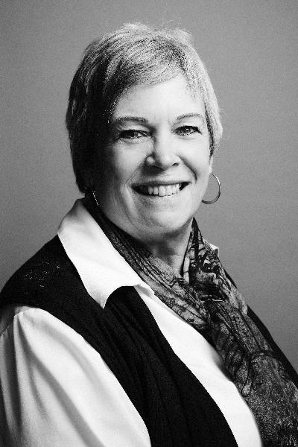
Nancy Hegarty
Harvard Faculty of Arts and Sciences

Slide 48
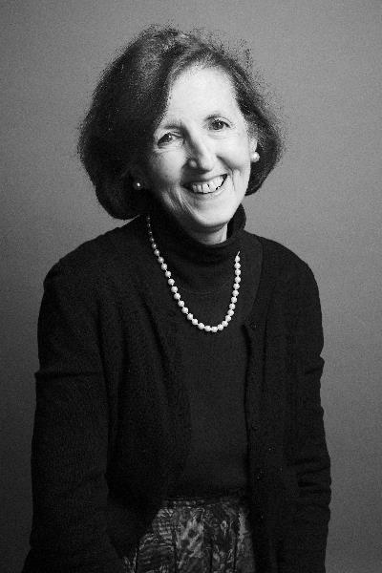
Peggy Herlihy
Harvard Faculty of Arts and Sciences

Slide 49
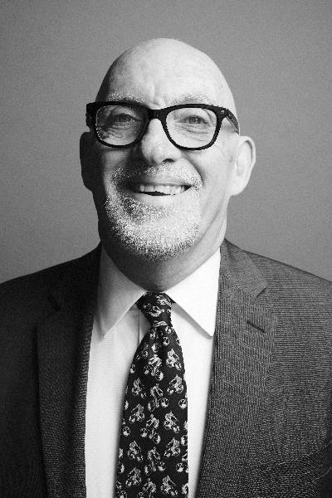
Garth McCavana
Harvard Faculty of Arts and Sciences

Slide 50
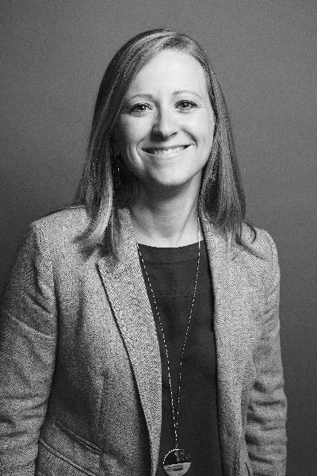
Erika McDonald
Harvard Faculty of Arts and Sciences

Slide 51
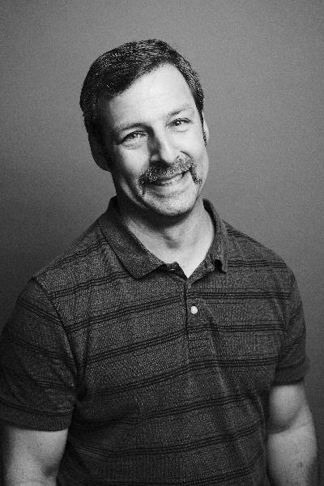
Michael Paterno
Harvard Faculty of Arts and Sciences

Slide 52
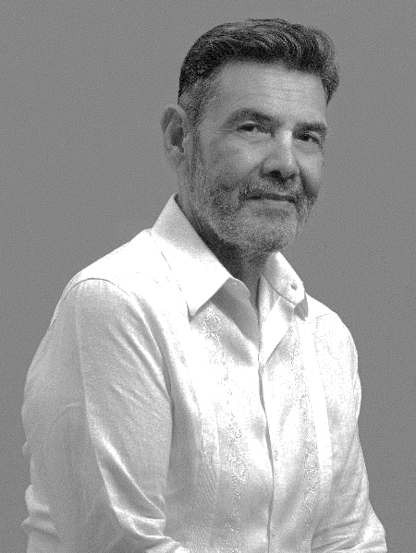
Hector Ruben Paz Nadal
Harvard Faculty of Arts and Sciences

Slide 53
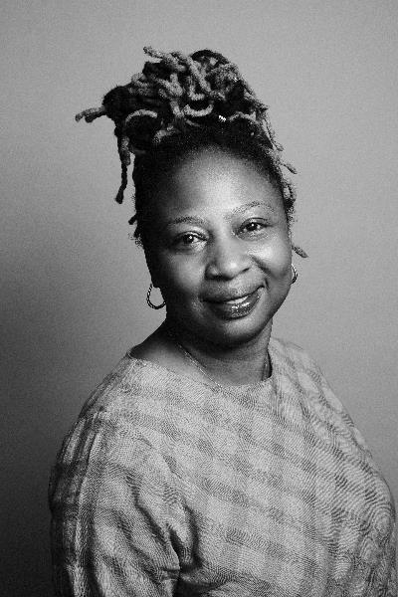
Rosaline Rabi Salifu Harvard Faculty of Arts and Sciences

Slide 54
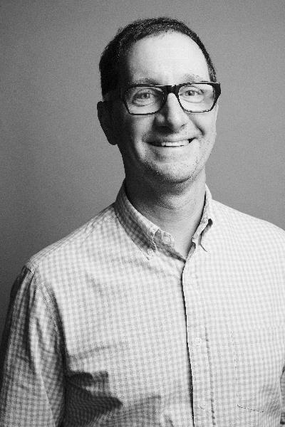
Clayton Scoble Harvard Faculty of Arts and Sciences

Slide 55
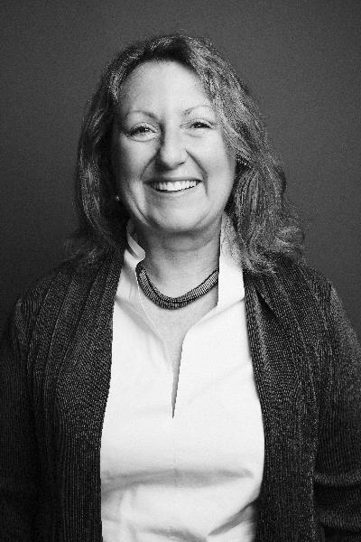
Amy Thompson Harvard Faculty of Arts and Sciences

Slide 56
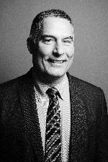

Slide 57
David King
Harvard Library

Slide 58
Carie McGinnis
Harvard Library

Slide 60
Amy Benson
Radcliffe Institute for Advanced Study

Slide 61
Afshaan Alter Burtram
Harvard Graduate School of Design

Slide 62
Shanton Anderson
Harvard University Information Technology

Slide 63
Alisa Jahns
Harvard University Information Technology

Slide 64
Albert Pacheco
Harvard University Information Technology

Slide 66
Daniel Hawkins
Harvard Divinity School

Slide 67
Nick Park
Harvard University Police Department

Slide 68
Santoshi Basnet
Harvard Graduate School of Education

Slide 69
Tracie Jones
Harvard Graduate School of Education

Slide 70
Rebecca Martin
Harvard Graduate School of Education

Slide 72
Diane Janelle Holland
Harvard University Health Services

Slide 73
Stephanie Mitchell
Harvard Public Affairs & Communications

Slide 74
Selina Lee
Harvard Human Resources

